Slide 1


Purdue University
Daniels School of Business
Final Project Presentation
Machine Learning
Presented By
Aishwarya Ajaykumar
Devarshi Sharma

Slide 2


Agenda
Problem Definition
The M5 Walmart Data
Sales Forecasting
Uncertainty determination
Segmenting Products
Promotion impact Analysis on Price
Image Recognition on Groceries

Slide 3
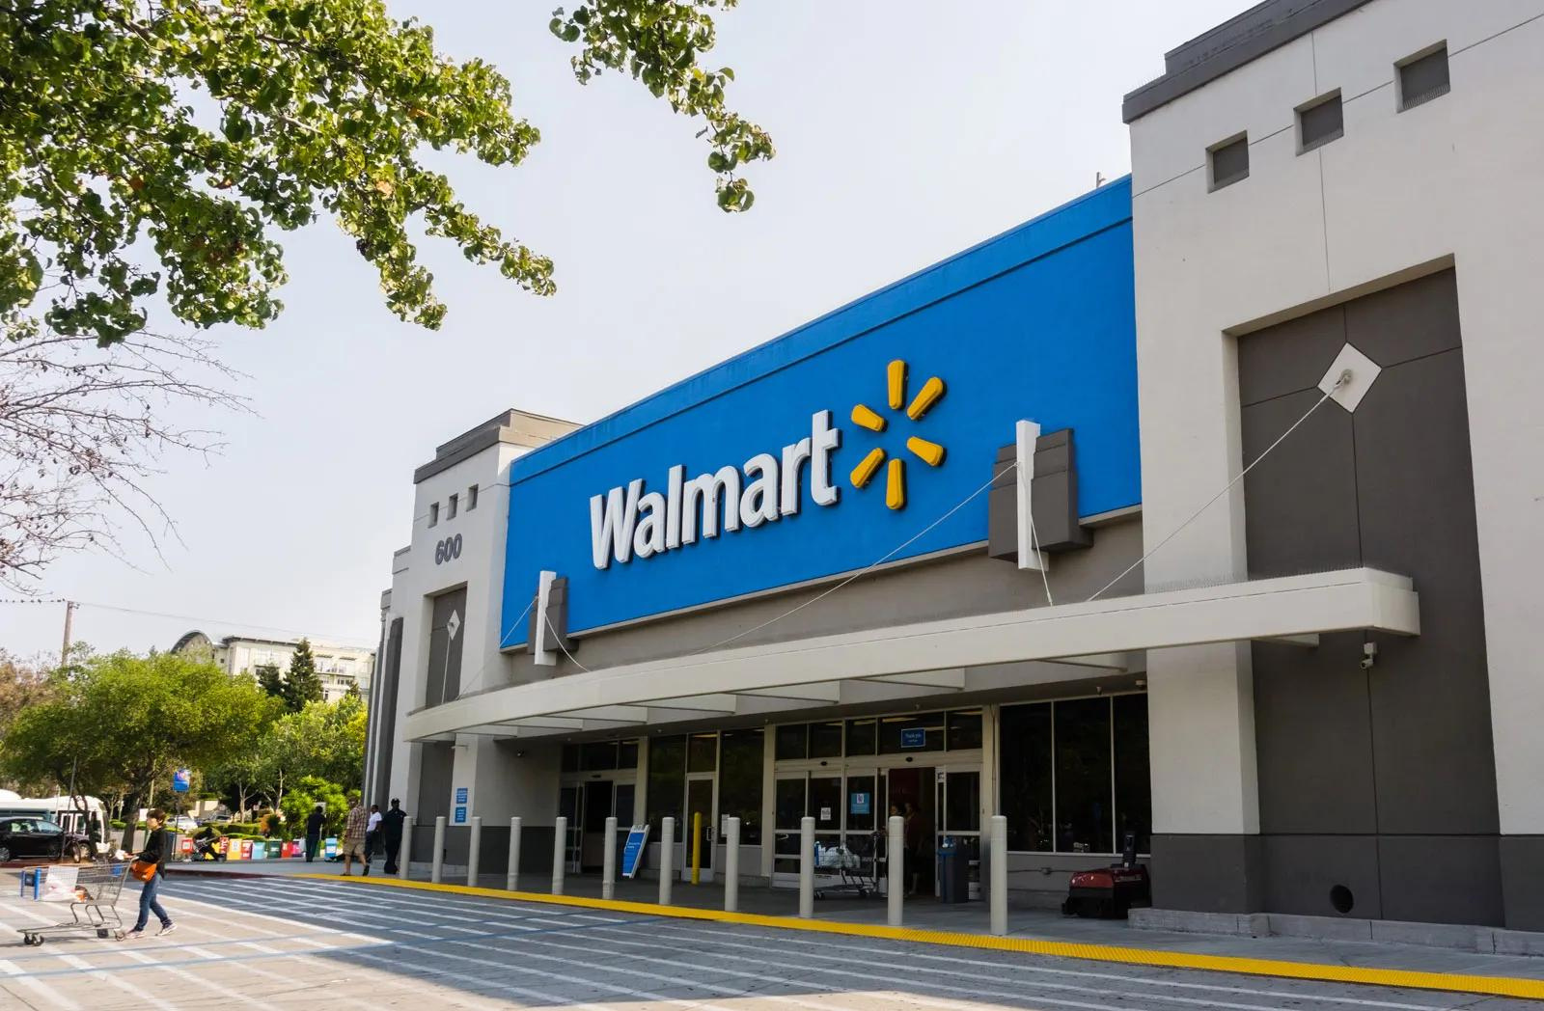
Problem Definition
Solution # 1
Sales Forecasting: Enhance inventory management and optimize supply chain decisions by predicting weekly sales of camping gear for the next 28 days, allowing for effective stock allocation and reduced holding costs. The company's first proposed solution.
Solution # 2
Uncertainty Estimation: Improve demand planning accuracy by forecasting daily sales while quantifying prediction uncertainty, enabling businesses to strategize buffer stock levels and manage risk more effectively.
Solution # 3
Promotion and Price Impact Analysis: Drive revenue growth and optimize marketing spend by analysing the influence of promotional activities on price and sales, ensuring a high ROI on marketing campaigns.
Solution # 4
Clustering for Inventory Strategies: Tailor inventory strategies with advanced segmentation of stores or products based on sales trends, leading to increased sales through targeted inventory distribution and replenishment.
Solution # 5
Walmart's use of image recognition technology can streamline the shopping experience by enhancing inventory management, expediting checkout processes, and improving customer service efficiency.

Slide 4
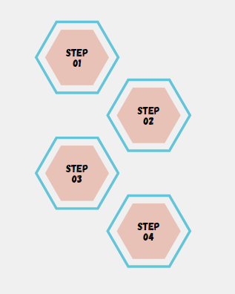
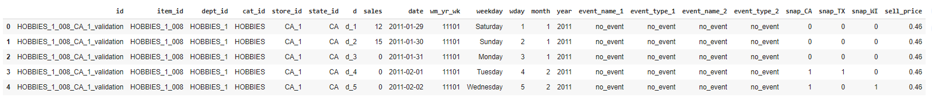
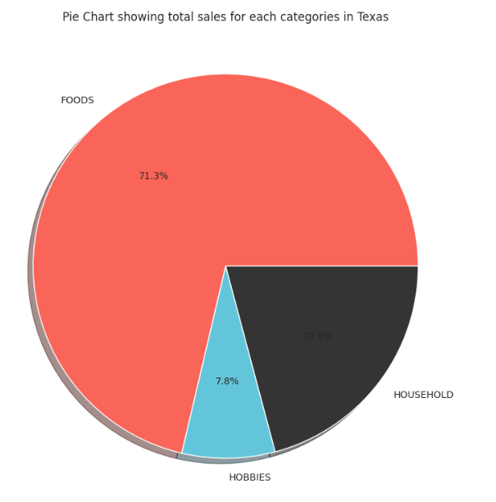
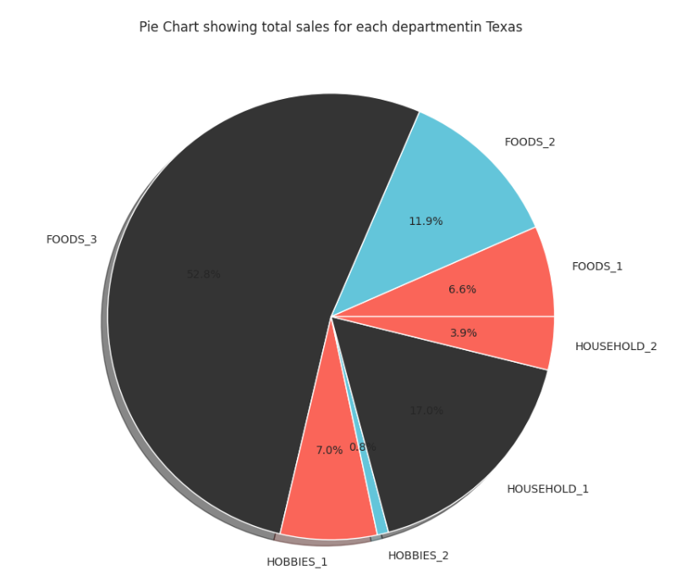
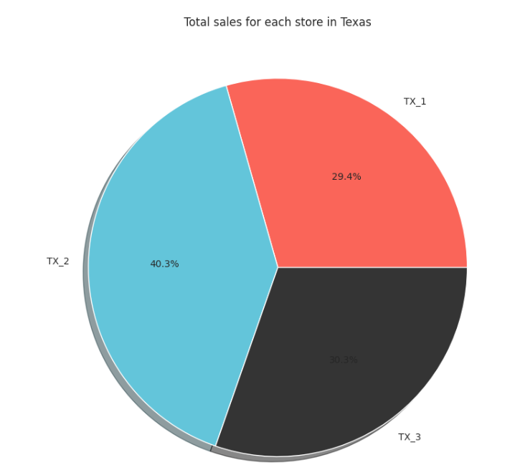

The Data
All Null values are imputed so that model can algorithm to function correctly
Filtering applied for Texas data
Data aggregated to month level in some cases
Total 3 States
Making all the 42840 combinations of the timeseries
Season information
Quarter, Month, Year Start and end flags
Inflation information
General holiday information in the US added as supplementary information for prediction
Data melted to make it in a long format in place of wide as depicted below
CA
TX
WI
Store 1
Store 2
Store 3
Lag features to capture complex temporal patterns and improve forecasting performance.
4, 8, 16, 20, 24 weeks
Category : Hobbies
Category : Food
Category : Household
Dept 1
Dept 2
Dept 3
Item 1
Item 2
Item 3
We have 6 years of data from 2011-2016(Only 4 months for 2016)
Texas data has 3 stores, with 3 categories each, 7 departments each and a total of ~7600 items
We are using Day 1 to 1914 as Train, Day 1914 to 1942 as Test

Slide 5
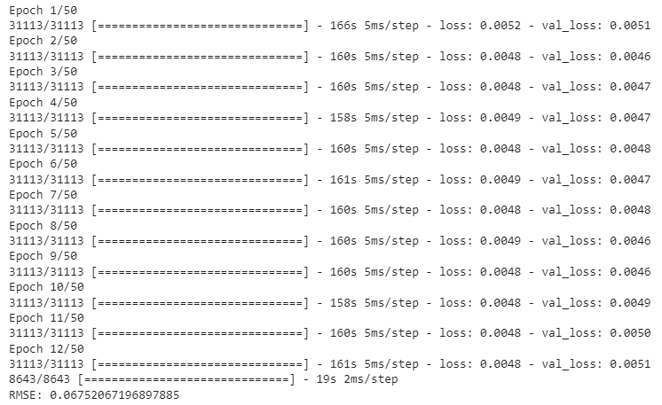
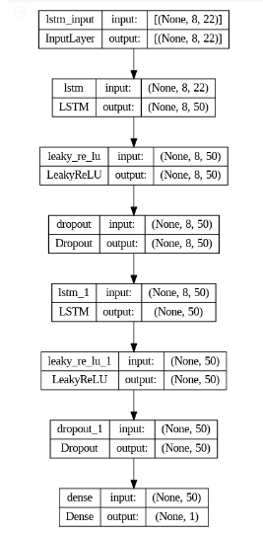
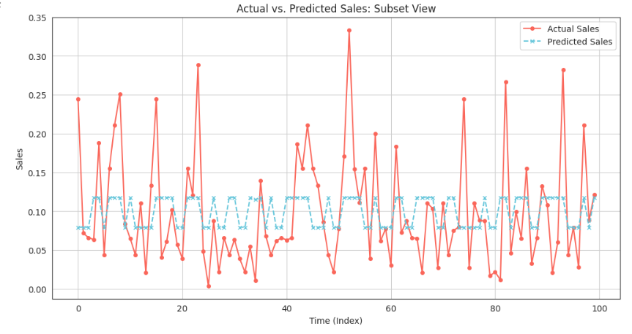
Sales Forecasting
Normalization
Inventory Optimization:
Sales forecasting in the supply chain enables businesses to anticipate demand fluctuations, aiding in the optimization of inventory levels to prevent overstocking or stockouts.
Data Preprocessing
Sequence Length
Feature Selection
Number of layers
Model Architecture
Number of Neurons
Improved Customer Service: Anticipating sales trends allows businesses to better meet customer demand, ensuring products are available when needed, thereby enhancing customer satisfaction and loyalty.
Bidirectional LSTM
Regularization and Dropout
Drop-out
L2 Regularization
Resource Allocation:
By accurately predicting sales, supply chain managers can efficiently allocate resources such as manpower, production capacity, and transportation, optimizing operations and reducing costs.
Batch Size and Epochs
Training Strategies
Learning Rate
Early Stopping
*Supply chains need at least a 4 week head-start to have adequate stock

Slide 6
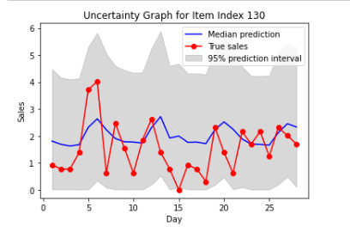
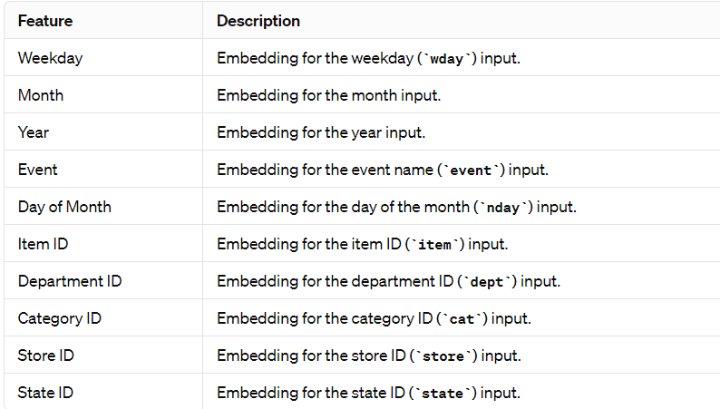
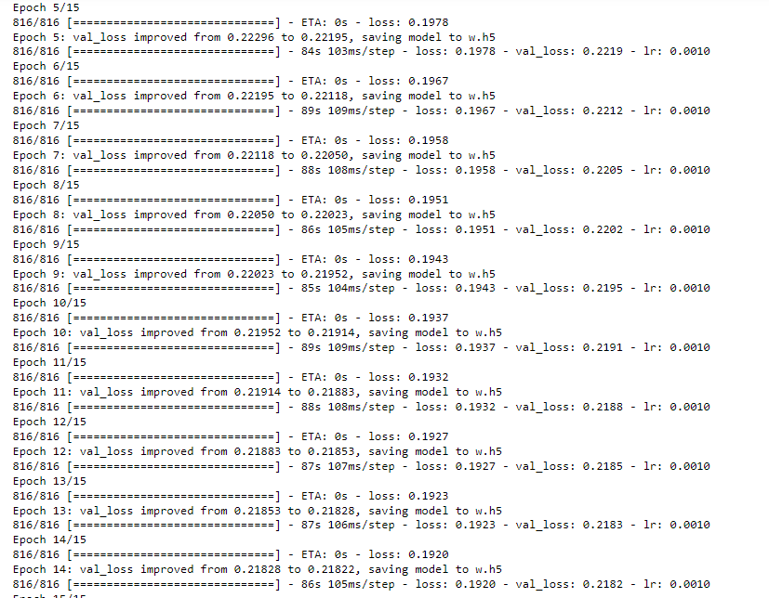
Uncertainty Determination
Aggregation and Embedding of Features
Risk Mitigation:
Uncertainty estimation in the supply chain allows businesses to identify and assess potential risks more accurately, enabling proactive risk management strategies to mitigate the impact of unforeseen events such as supply chain disruptions or demand fluctuations.
Optimized Inventory Management:
By quantifying prediction uncertainty, businesses can adjust buffer stock levels more precisely, ensuring adequate inventory to meet demand variability while minimizing excess inventory holding costs.
Flatten and Concatenate
Relu
2 Dense Layered NN (125 each )
Enhanced Decision-Making: Incorporating uncertainty estimation into demand planning processes provides decision-makers with more reliable forecasts and a clearer understanding of potential deviations, facilitating informed decision-making and improving overall supply chain resilience.
Linear
Dense Layer ( 9 dimension )

Slide 7
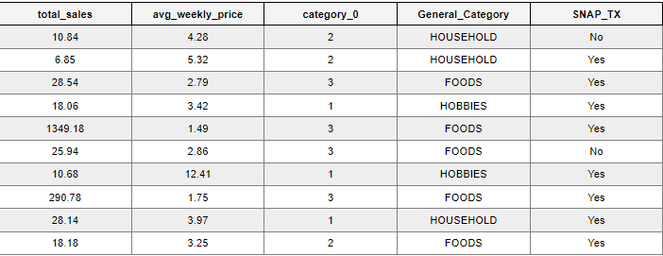
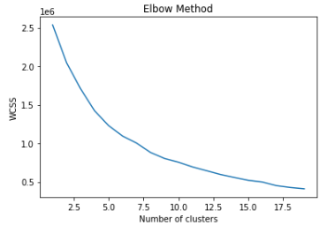
Products Segmentation
Weekly Aggregation of Data with SNAP and Event Data
Optimize Inventory for High-Volume, Low-Cost Items Items in clusters with high total sales and lower average weekly prices are likely essential goods with consistent demand. Walmart should ensure that these items are always in stock, leveraging their strong supply chain capabilities.
Finding K for K means using Elbow Method
Tailor Marketing Strategies Based on SNAP_TX Activation
Clusters indicating high sales where SNAP_TX is active suggest these products are popular among SNAP beneficiaries. Walmart could run targeted promotions to coincide with SNAP benefit distribution dates.
Application Methods
Coordinate with suppliers to offer discounts or bundle deals on SNAP eligible items during the first week of the month, which is typically when SNAP benefits are distributed.
Review inventory turnover rates for these items and adjust restocking strategies to prevent stockouts.
Conduct A/B testing with different pricing strategies for items within this cluster to determine price elasticity and customer response.
Strategic Pricing Adjustments for Premium Categories
Clusters with lower total sales volumes and higher prices are likely to represent premium or non-essential items. Walmart could experiment with dynamic pricing strategies to find the optimal balance between price and sales volume.

Slide 8
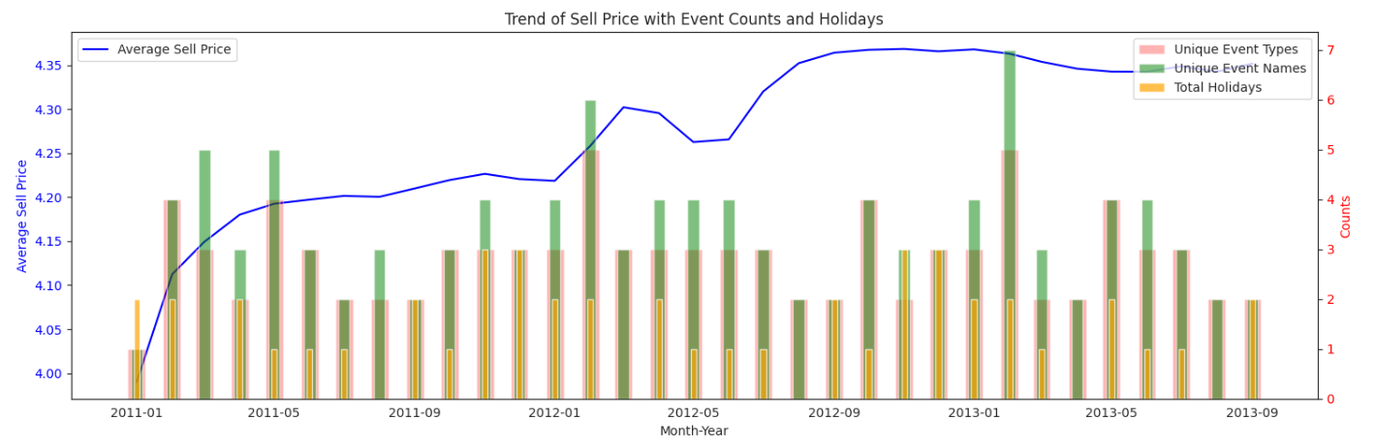
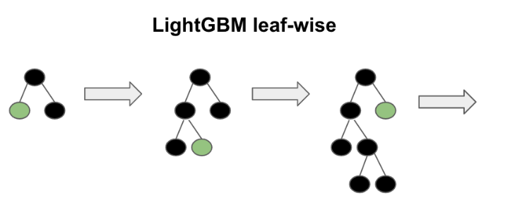
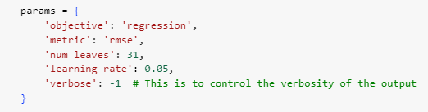
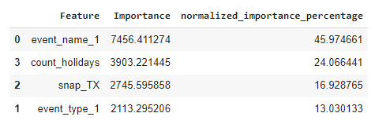
Promotion Impact Analysis
Demand Forecasting and Inventory Management:
Promotion impact analysis facilitates optimized inventory levels by forecasting demand fluctuations during promotions and minimizing excess stock during non-promotional periods, enhancing overall inventory management efficiency.
Price Elasticity Estimation:
Analysing promotion effects aids in estimating price elasticity, guiding pricing strategies for maximizing revenue by understanding consumer responses to price changes.
Correlation: There seems to be some correlation between events and sell prices, especially noticeable in periods where higher counts of events or holidays coincide with peaks in sell prices. This suggests that there might be a relationship between promotional activities, holidays, and pricing strategies.
Seasonality: The graph may also hint at seasonality in the data, where certain times of the year show higher prices or more events, possibly due to seasonal demand or seasonal promotional activities.
Consumer Behaviour Insights: Analysing the impact of promotions on pricing provides valuable insights into consumer behaviour, thereby enabling the development of targeted marketing strategies for improved sales and profitability.
*Assumption : Holiday events have a promotion associated with it

Slide 9
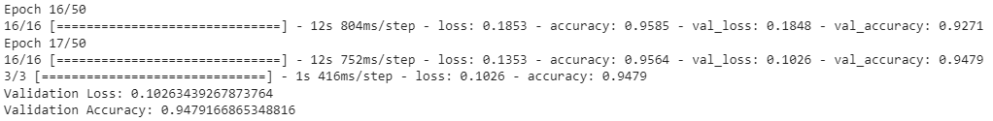







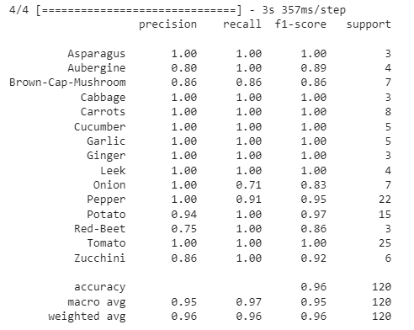
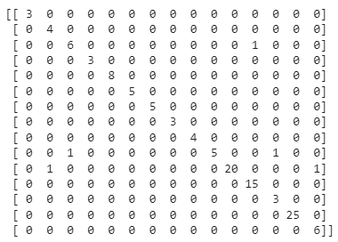
Image Recognition for Groceries
Enhanced Inventory Management: Image recognition technology can automate the tracking of stock levels, reducing manual inventory checks and improving accuracy. This leads to more efficient restocking processes and minimized out-of-stock scenarios, enhancing customer satisfaction.
Image
Preparation
Improved Checkout Efficiency: Utilizing image recognition at checkout can speed up the scanning process of groceries, reducing wait times for customers. This technology can identify products without traditional barcodes, streamlining the checkout process and improving overall customer experience.
Base Model Loading: Load MobileNetV2
Model Architecture
Adding Layers: Append GlobalAveragePooling2D, Dense, Dropout, and a final Dense layer
Loss Function, Optimizer
Fraud Detection and Prevention: Image recognition can help in identifying discrepancies between the item scanned and the item billed, reducing instances of fraud. By ensuring that the item being scanned matches the product description and price, Walmart can enhance security and prevent losses due to pricing errors or fraudulent activities.
Training Strategies
Class Weights
Callbacks: Use EarlyStopping and ModelCheckpoint

Slide 10
Thank You!

